Slide 1
Text Analysis

Slide 2
Exploratory Text Analysis
Oftentimes, one starts a text analysis project in an exploratory phase
Text analysis is rarely effective looking at one single text because there is not enough data (words in the document) to claim statistical significance -- the likelihood that something does not happen by chance -- about any patterns one finds
Watch tutorial about exploratory text analysis with Voyant

Slide 3
Key Terms
Stopwords - list of words not to be used in the text analysis program to stop the analysis from being skewed towards less important words; these words are typically occurring conjunctions (but, and, etc.) and article (the, a, etc.) but can also be character names
Wildcards - using the asterisk symbol in one’s search term to get multiple variants of a word
call* = call, calls, called, calling
Raw/Relative Frequency - the actual content of the words in a corpus / the percentage of times a word occurs in a corpus compared to rest of words in the corpus

Slide 4
Key Terms
Density - number of times of word is mentioned in a corpus divided by the number of words in the corpus
Correlation - number that determines the frequency with which terms appear together or not

Slide 5
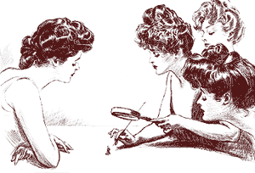
The Yellow Wallpaper: Breakout Groups (15-20 mins)
Retrieve the Project Gutenberg text file of The Yellow Wallpaper.

Slide 6
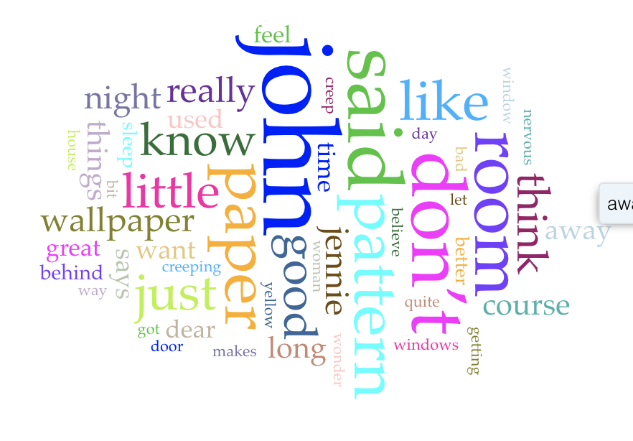
Word Clouds
Notes:
Word clouds visualize terms in the corpus that occur the most frequently. The most common terms in the corpus are positioned centrally and are sized the largest. The color of words and their position are not significant.

Slide 7
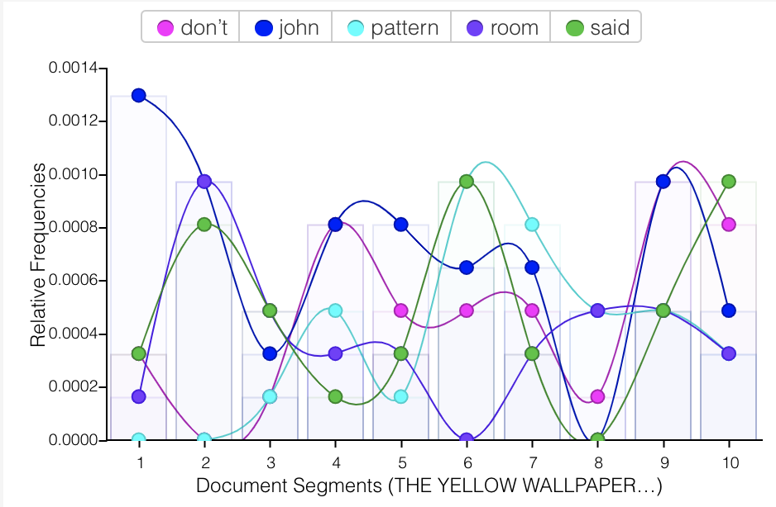
Frequency Graphs
Notes:
Frequency graphs represent how often terms terms appear across documents in a corpus or across segments in a document. Each series in the graph is colored according to the word it represents, at the top of the graph a legend displays which words are associated with which colors.

Slide 8
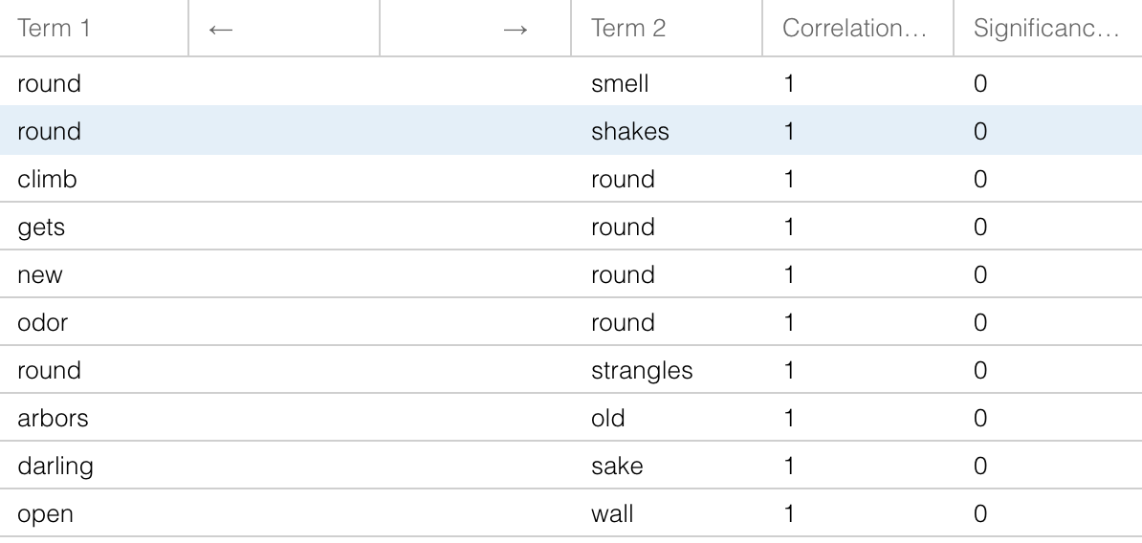
Correlations
Notes:
The correlation table show the relative frequencies with which terms appear together in the corpus. A correlation number at or near 1 suggests that the terms are very likely to occur near each other and a correlation number at or near -1 suggests that the presence of one term means the other term is not likely to appear next to it. The significance value is a measure of confidence that the correlation value is correct. A significance value of .5 or less suggest that the correlation value is a pattern worth noting. In the example above, the corpus size - 1 document - is too small to determine that the correlation value is significant enough to suggest an interesting pattern worth looking into further.

Slide 9
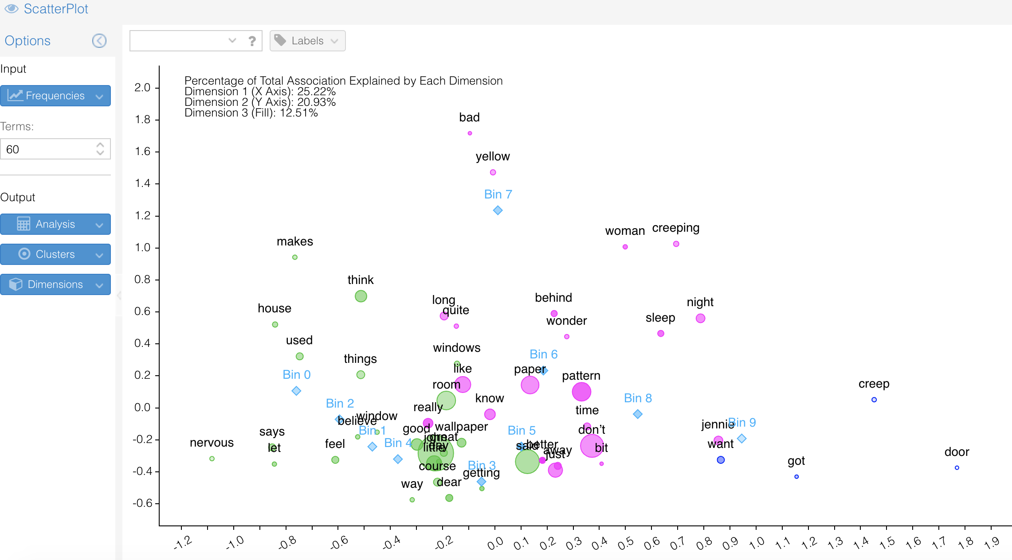
Scatter Plot
Notes:
A scatter plot displays many dimensions of a corpus into 2-3 dimension. Words that are grouped together follow similar usage in the corpus. In the above explain the “Bin #” values are segments of the document. If we were using a corpus, those values would change to documents in the corpus.

